Slide 1
Exercise 3
Repeat both exercises 1 and 2, considering both SMOTE and simple oversampling as resampling methods and compare the achieved results (the minority class should contain the same number than instances of the initial majority class).
To compare the achieved results, remove the duplicated instances and return, for each resampling method, the final number of instances and check the class distribution.
Adopt the multi-filter for solving the exercises.

Slide 2
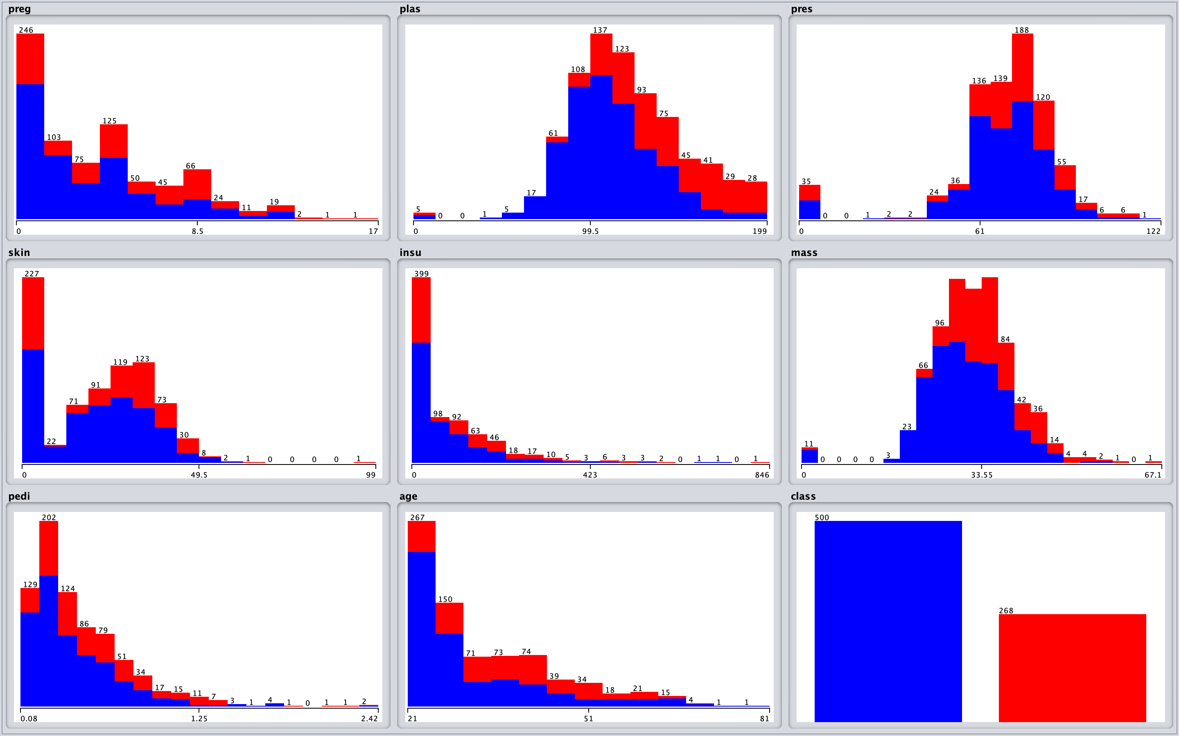
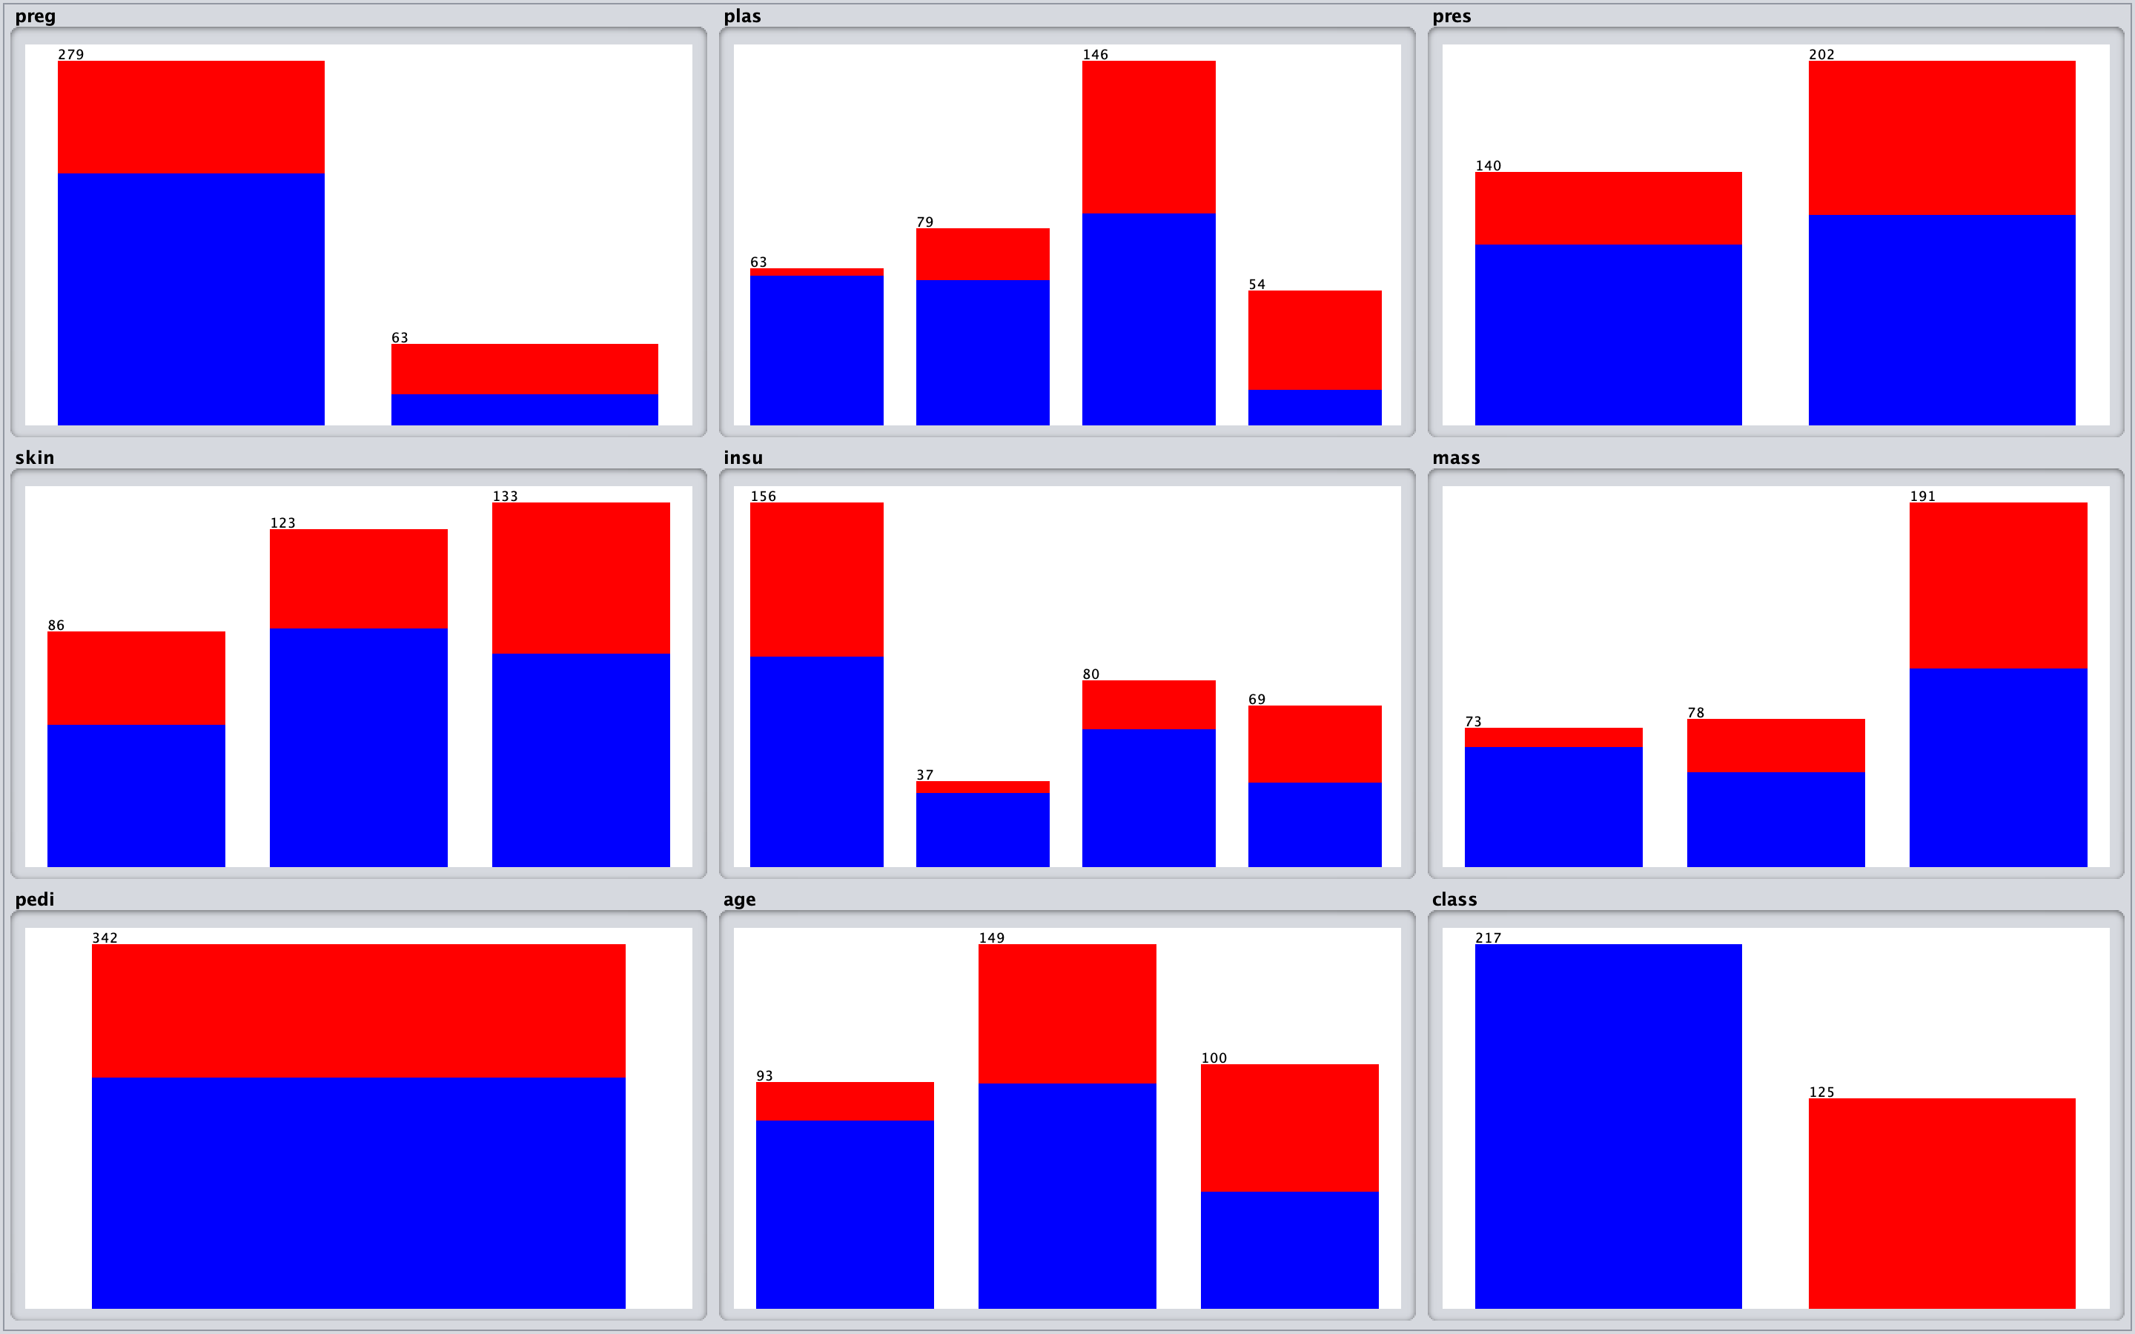
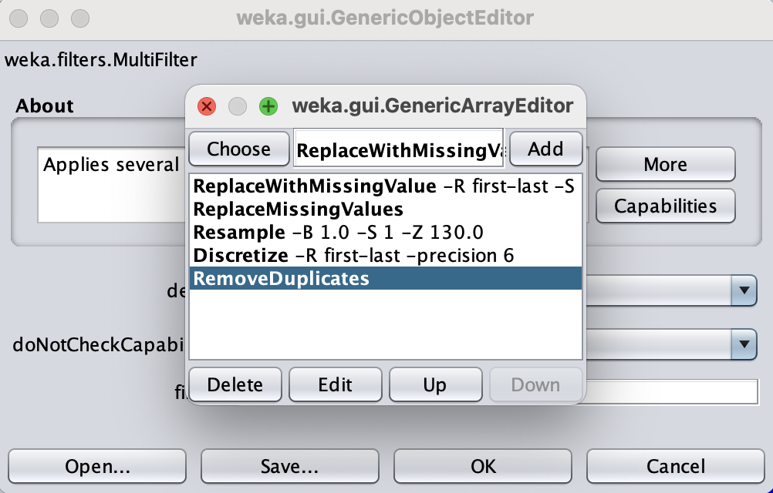
Diabetes.arff with multifilter (Resample)
We can see the starting data-set on the left
The results, on the right, are obtained by applying the multifilter
The total amount of instances change from 768 to 342

Slide 3
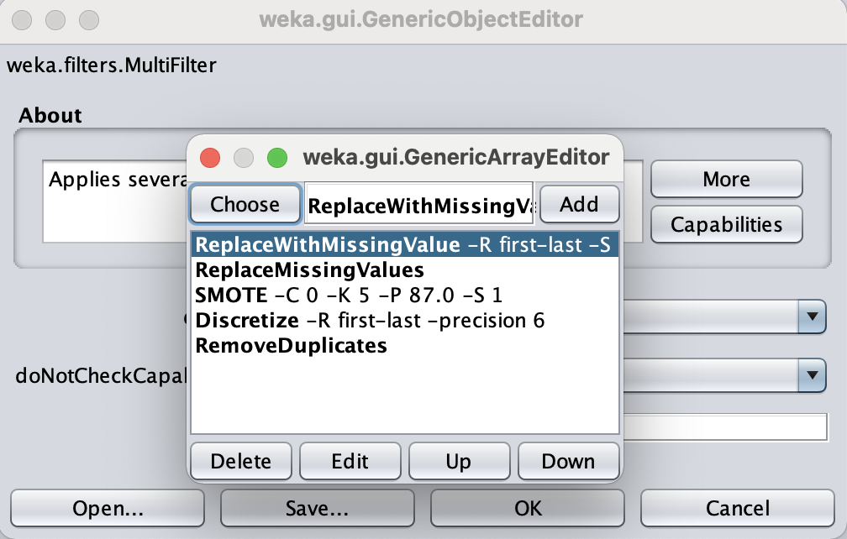
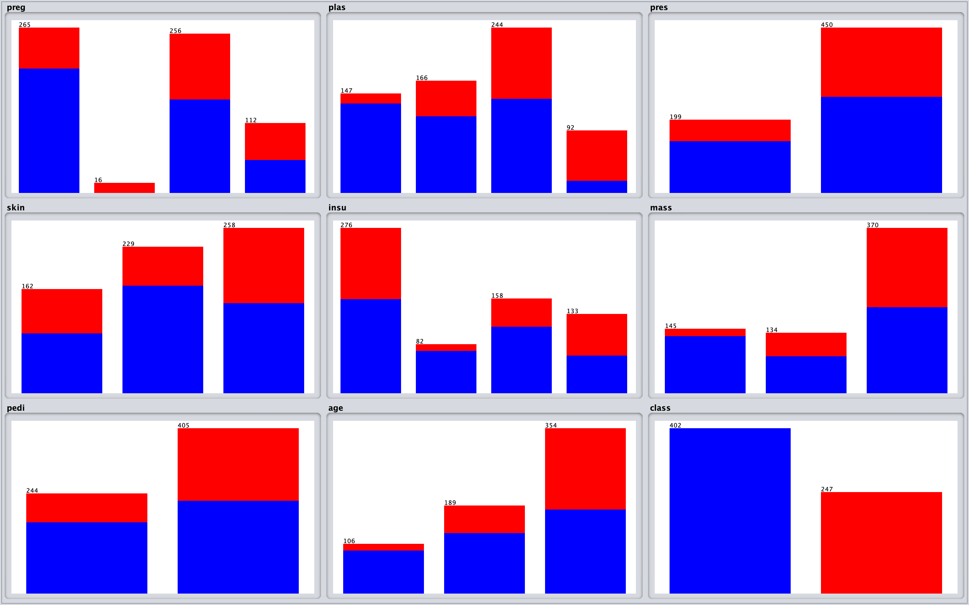
Diabetes.arff with multifilter (Smote)
In this case we have applied the the Smote filter instead of using the Resample one
We leave to 0 the classValue parameter so the filter will auto-detect the minority class, we set the percentage to 87 in order to obtain and equal distribution of the two classes. After the removing of duplicates the total instances are 649

Slide 4
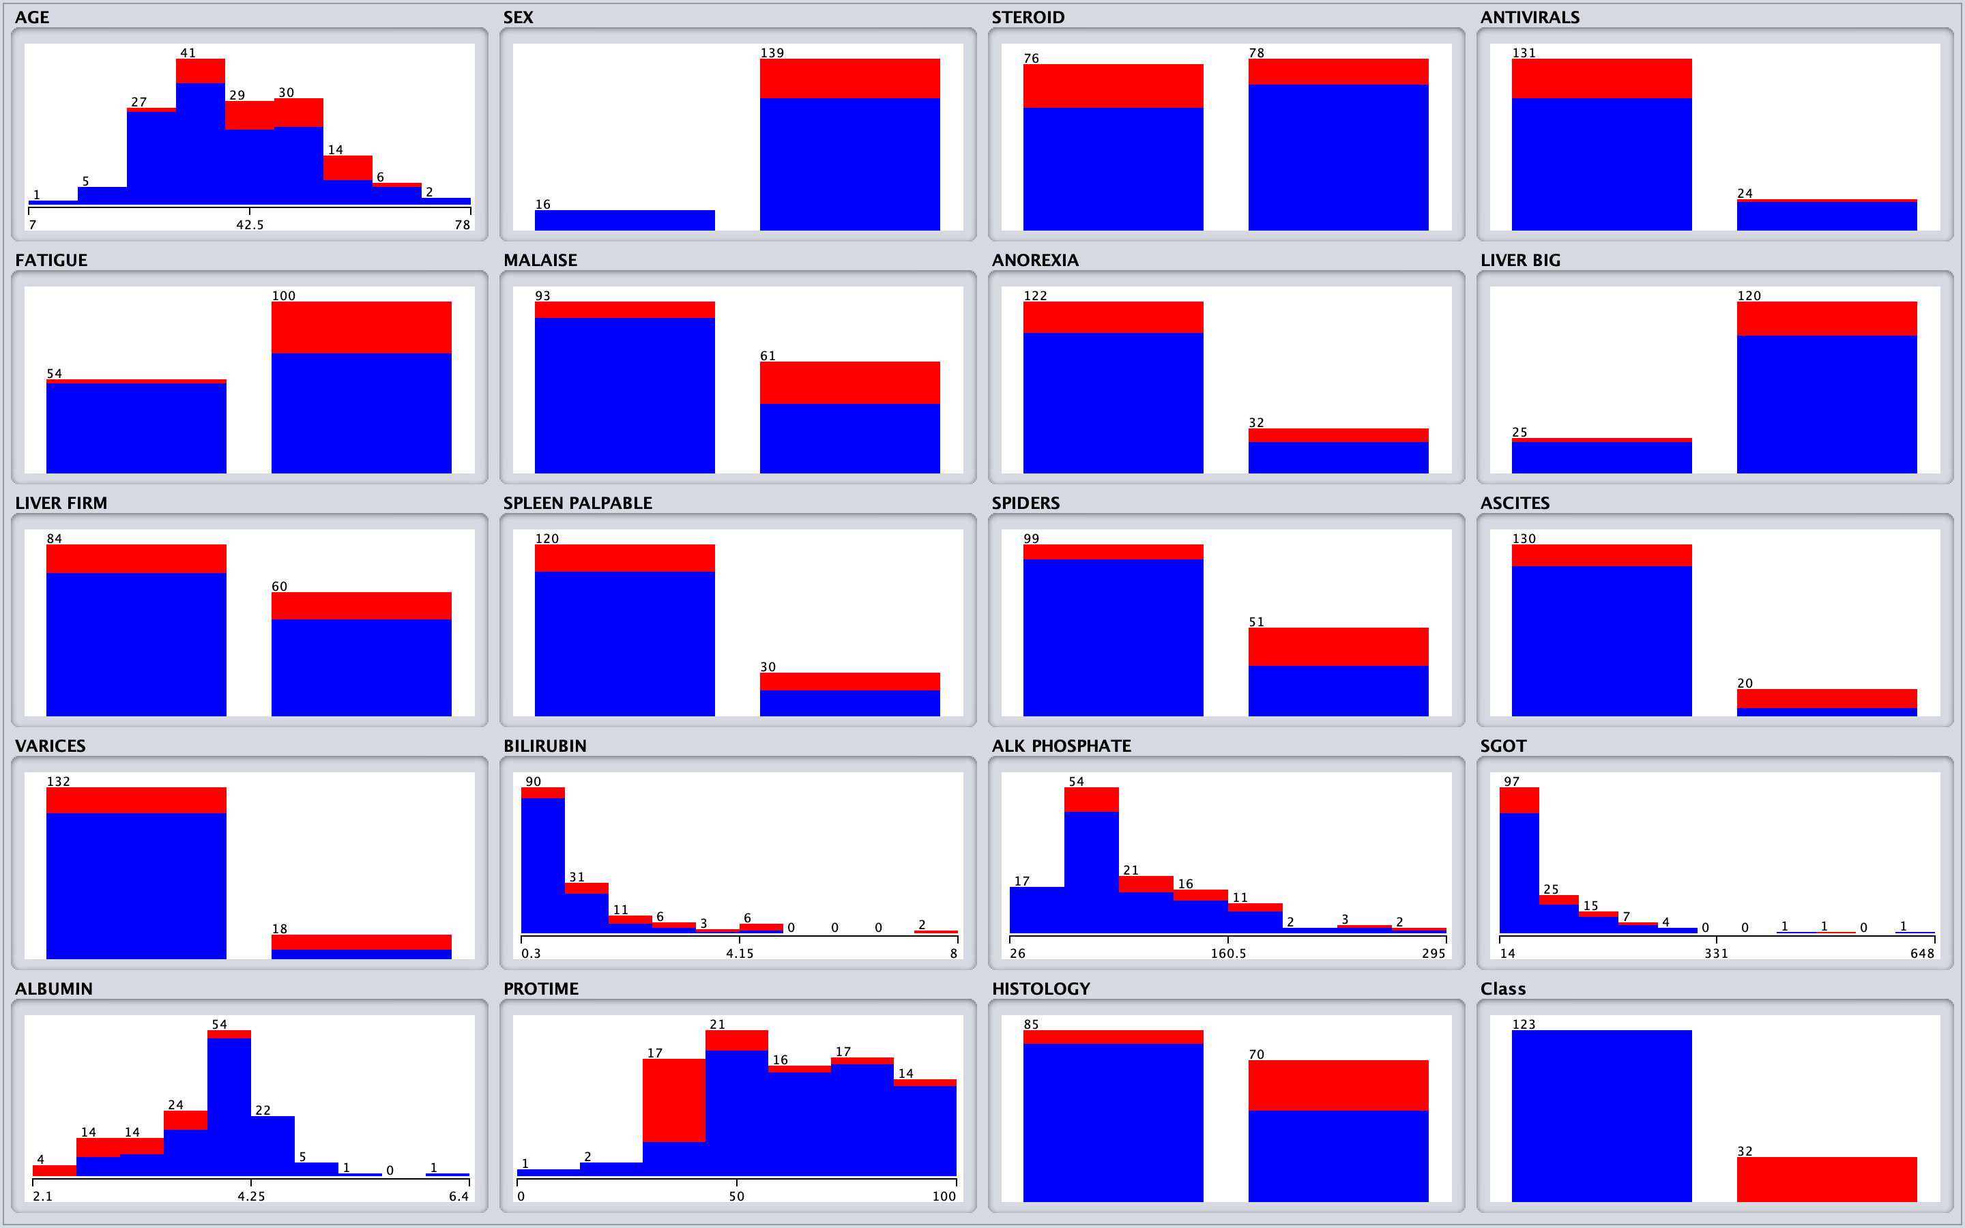
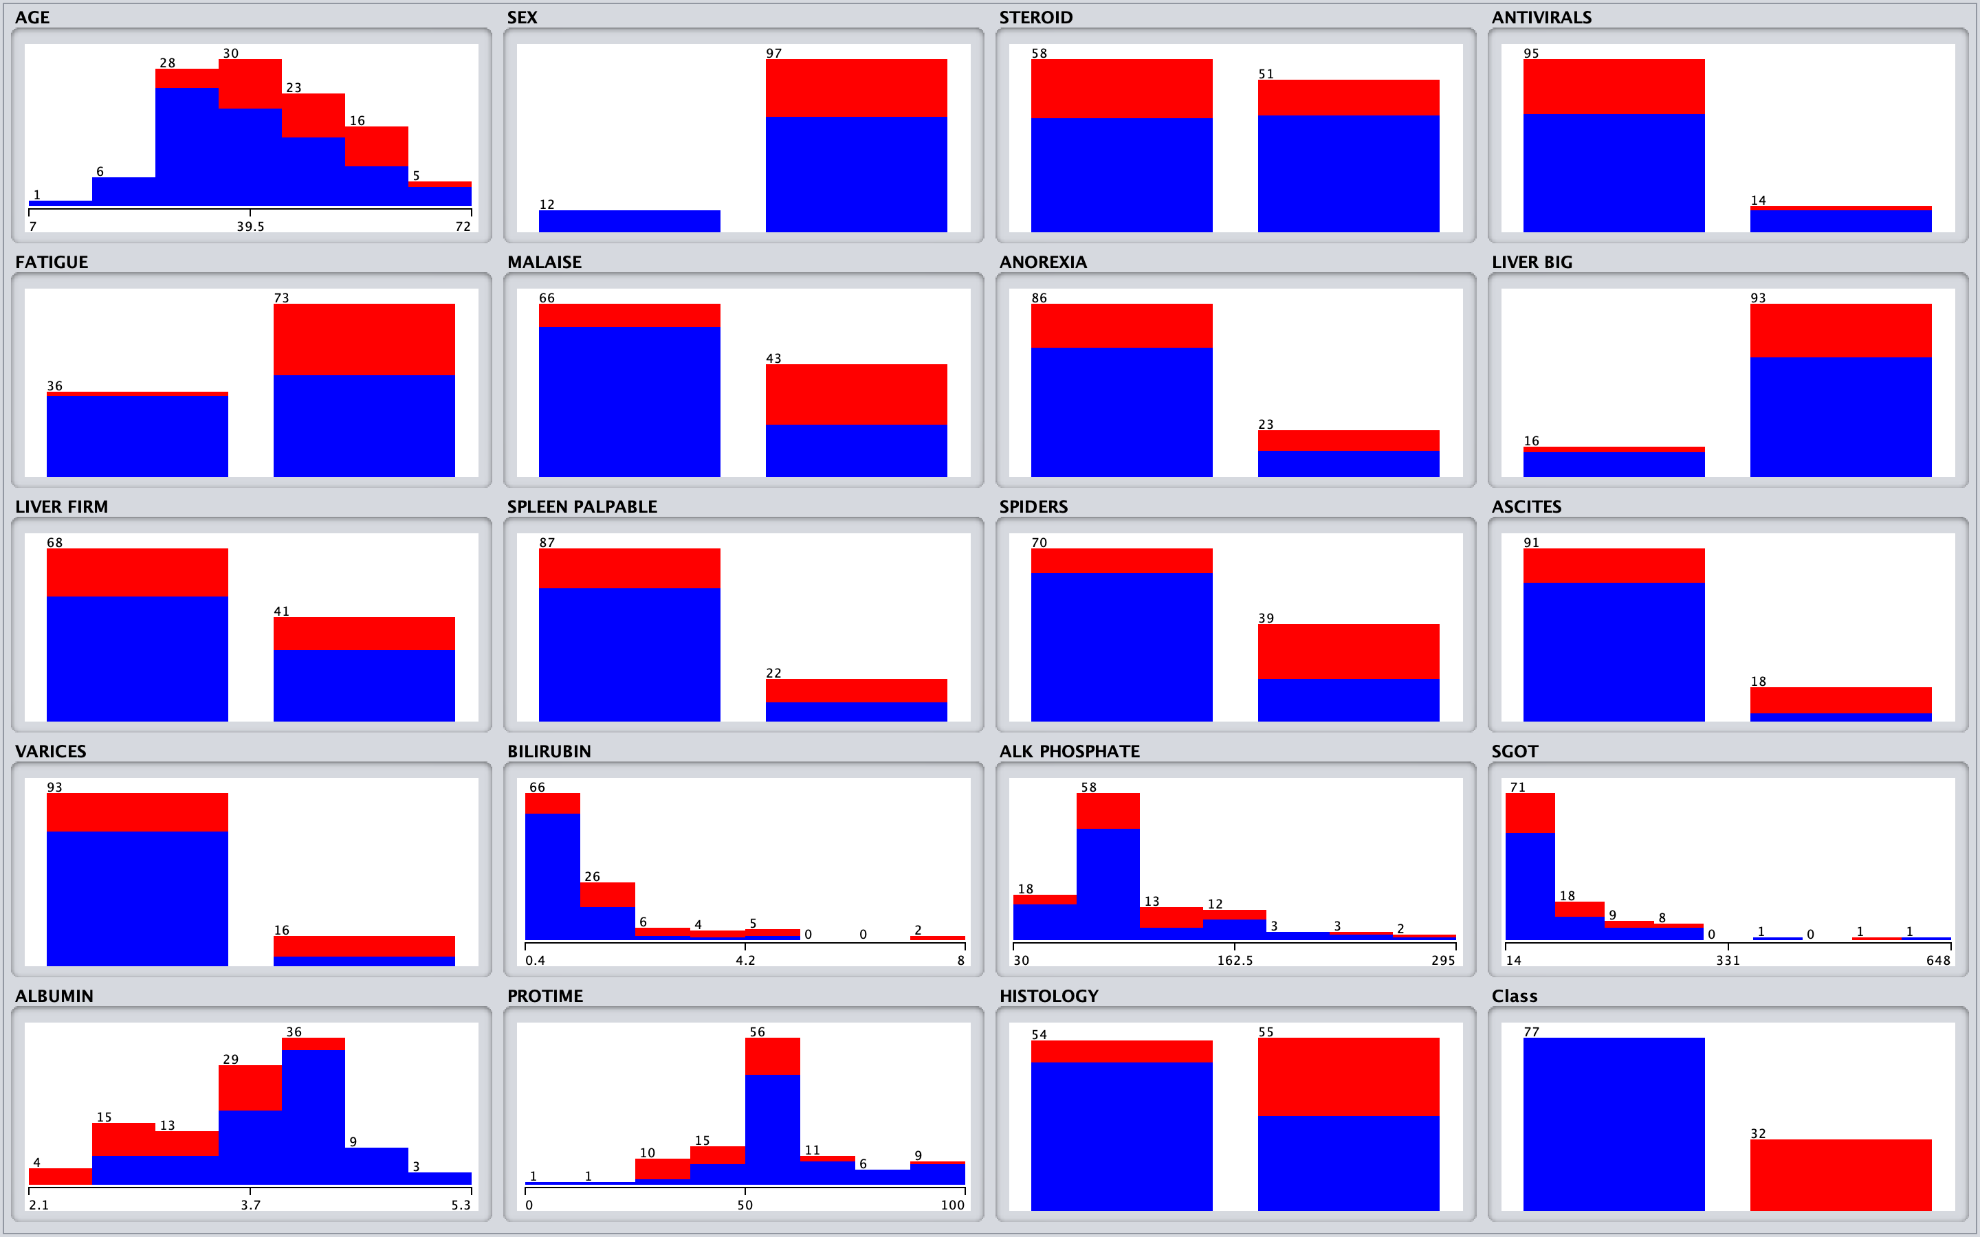
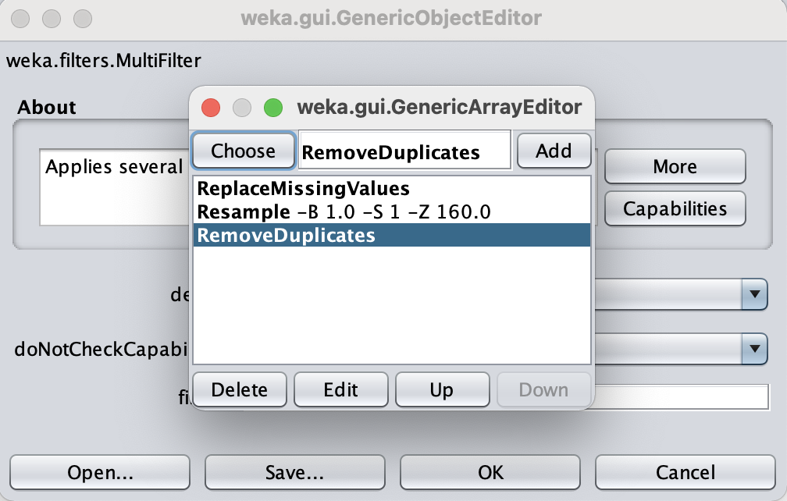
Hepatitis.csv with multifilter (Resample)
As in the Diabetes case, on the left, the starting data-set and on the right the result obtained using the multifilter
The total instances varieties from 155 to 109

Slide 5
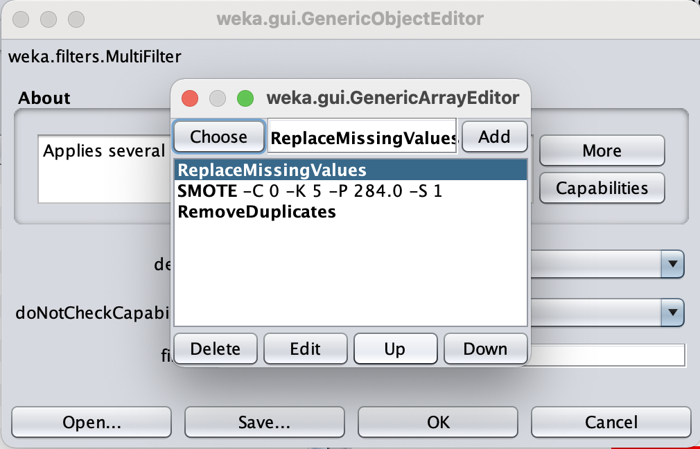
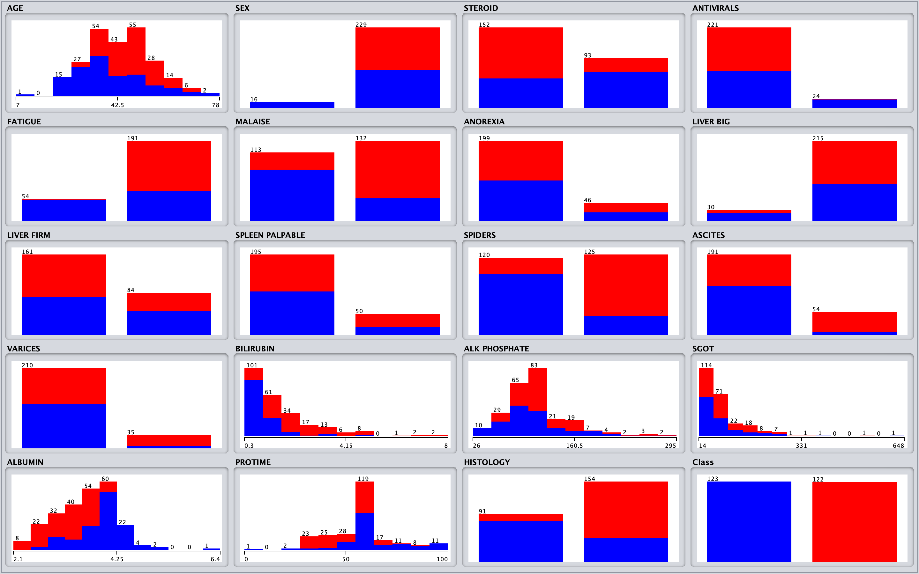
Hepatitis.csv with multifilter (Smote)
This results are obtained using Smote filter instead of Resample filter.
The total of unique instances are : 245

Slide 6
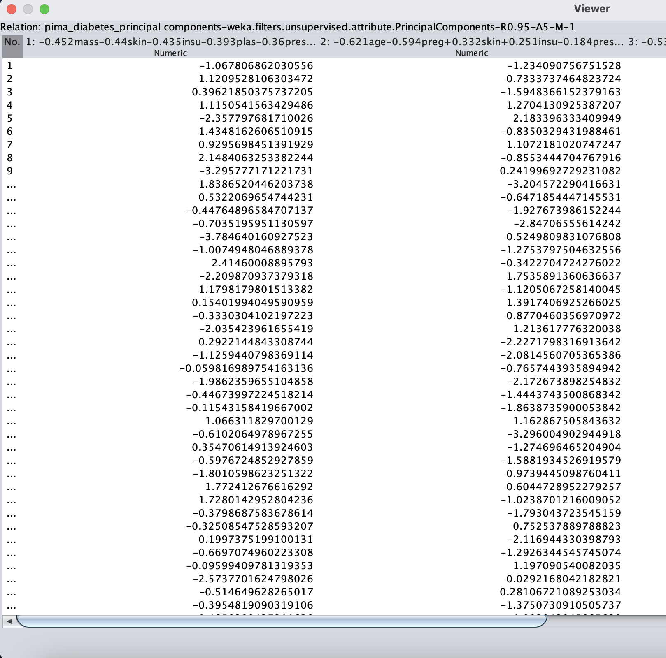
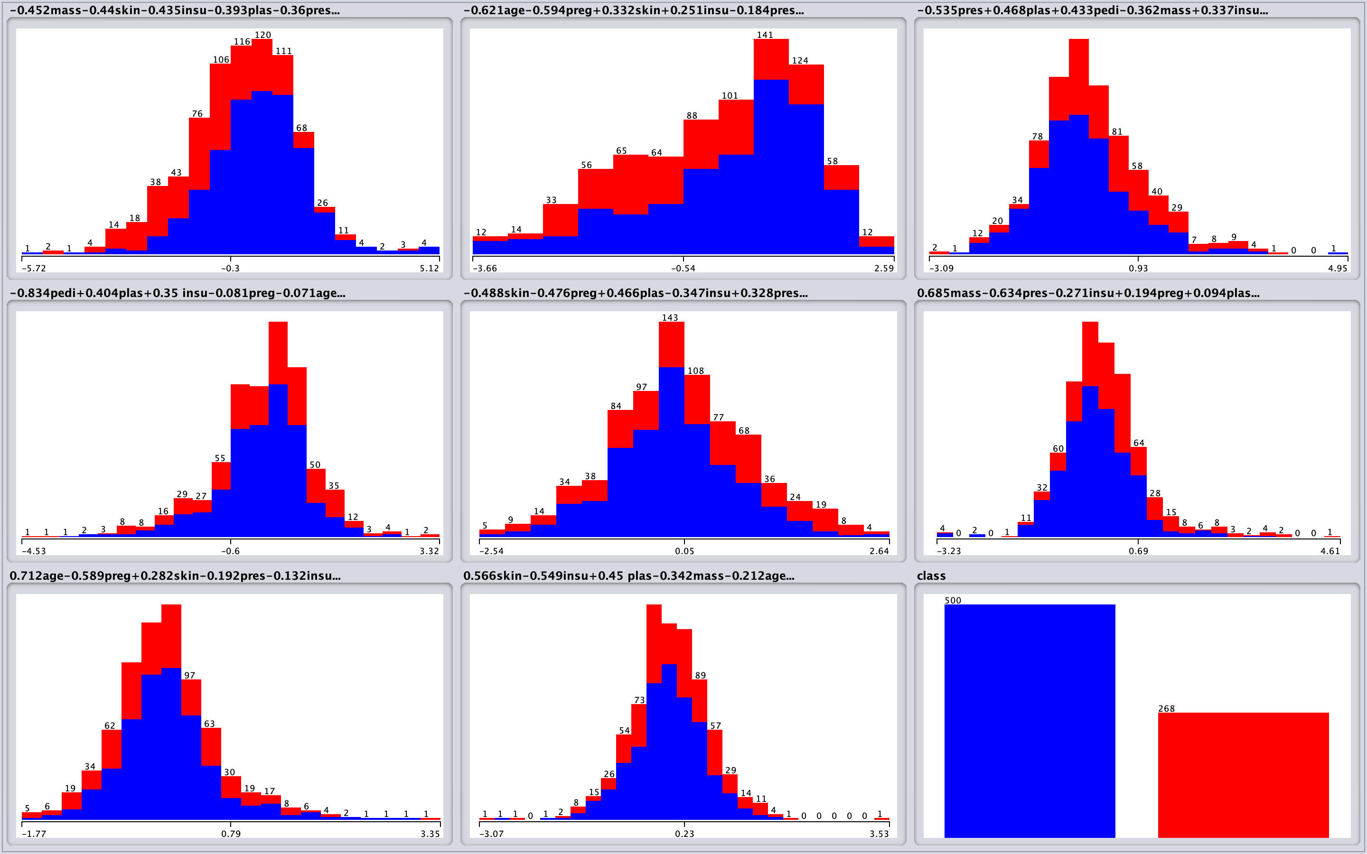
Diabetes.arff PCA

Slide 7
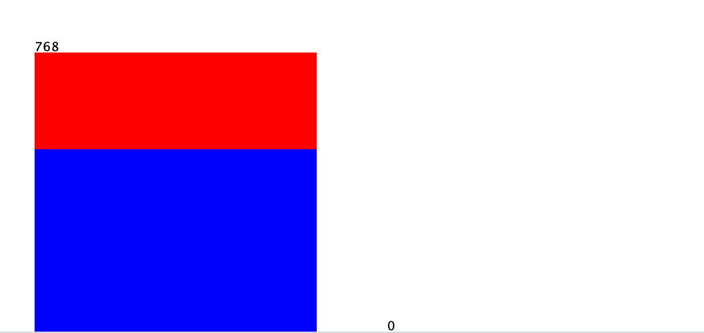
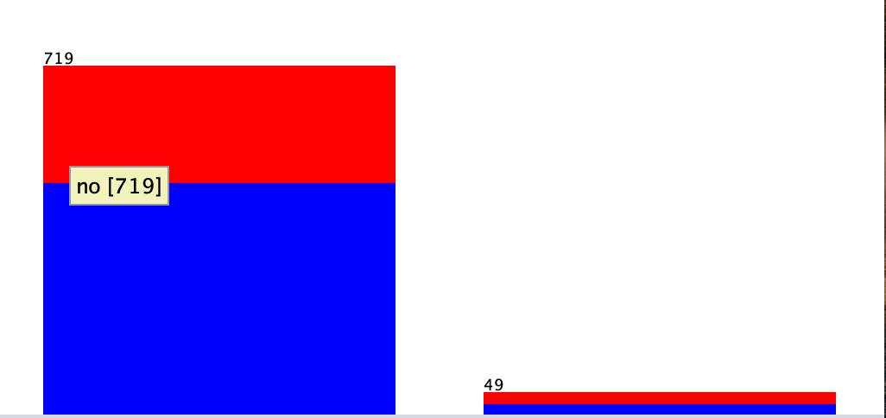
Diabetes.arff InterquartileRange
There aren’t extreme values
There are 49 outliers

Slide 8
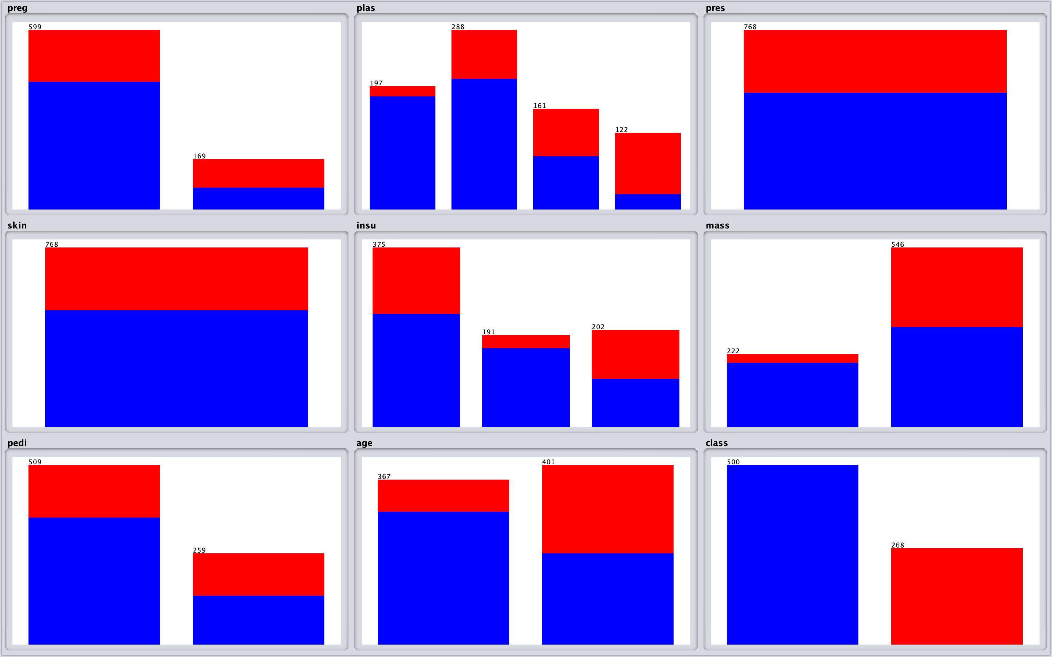
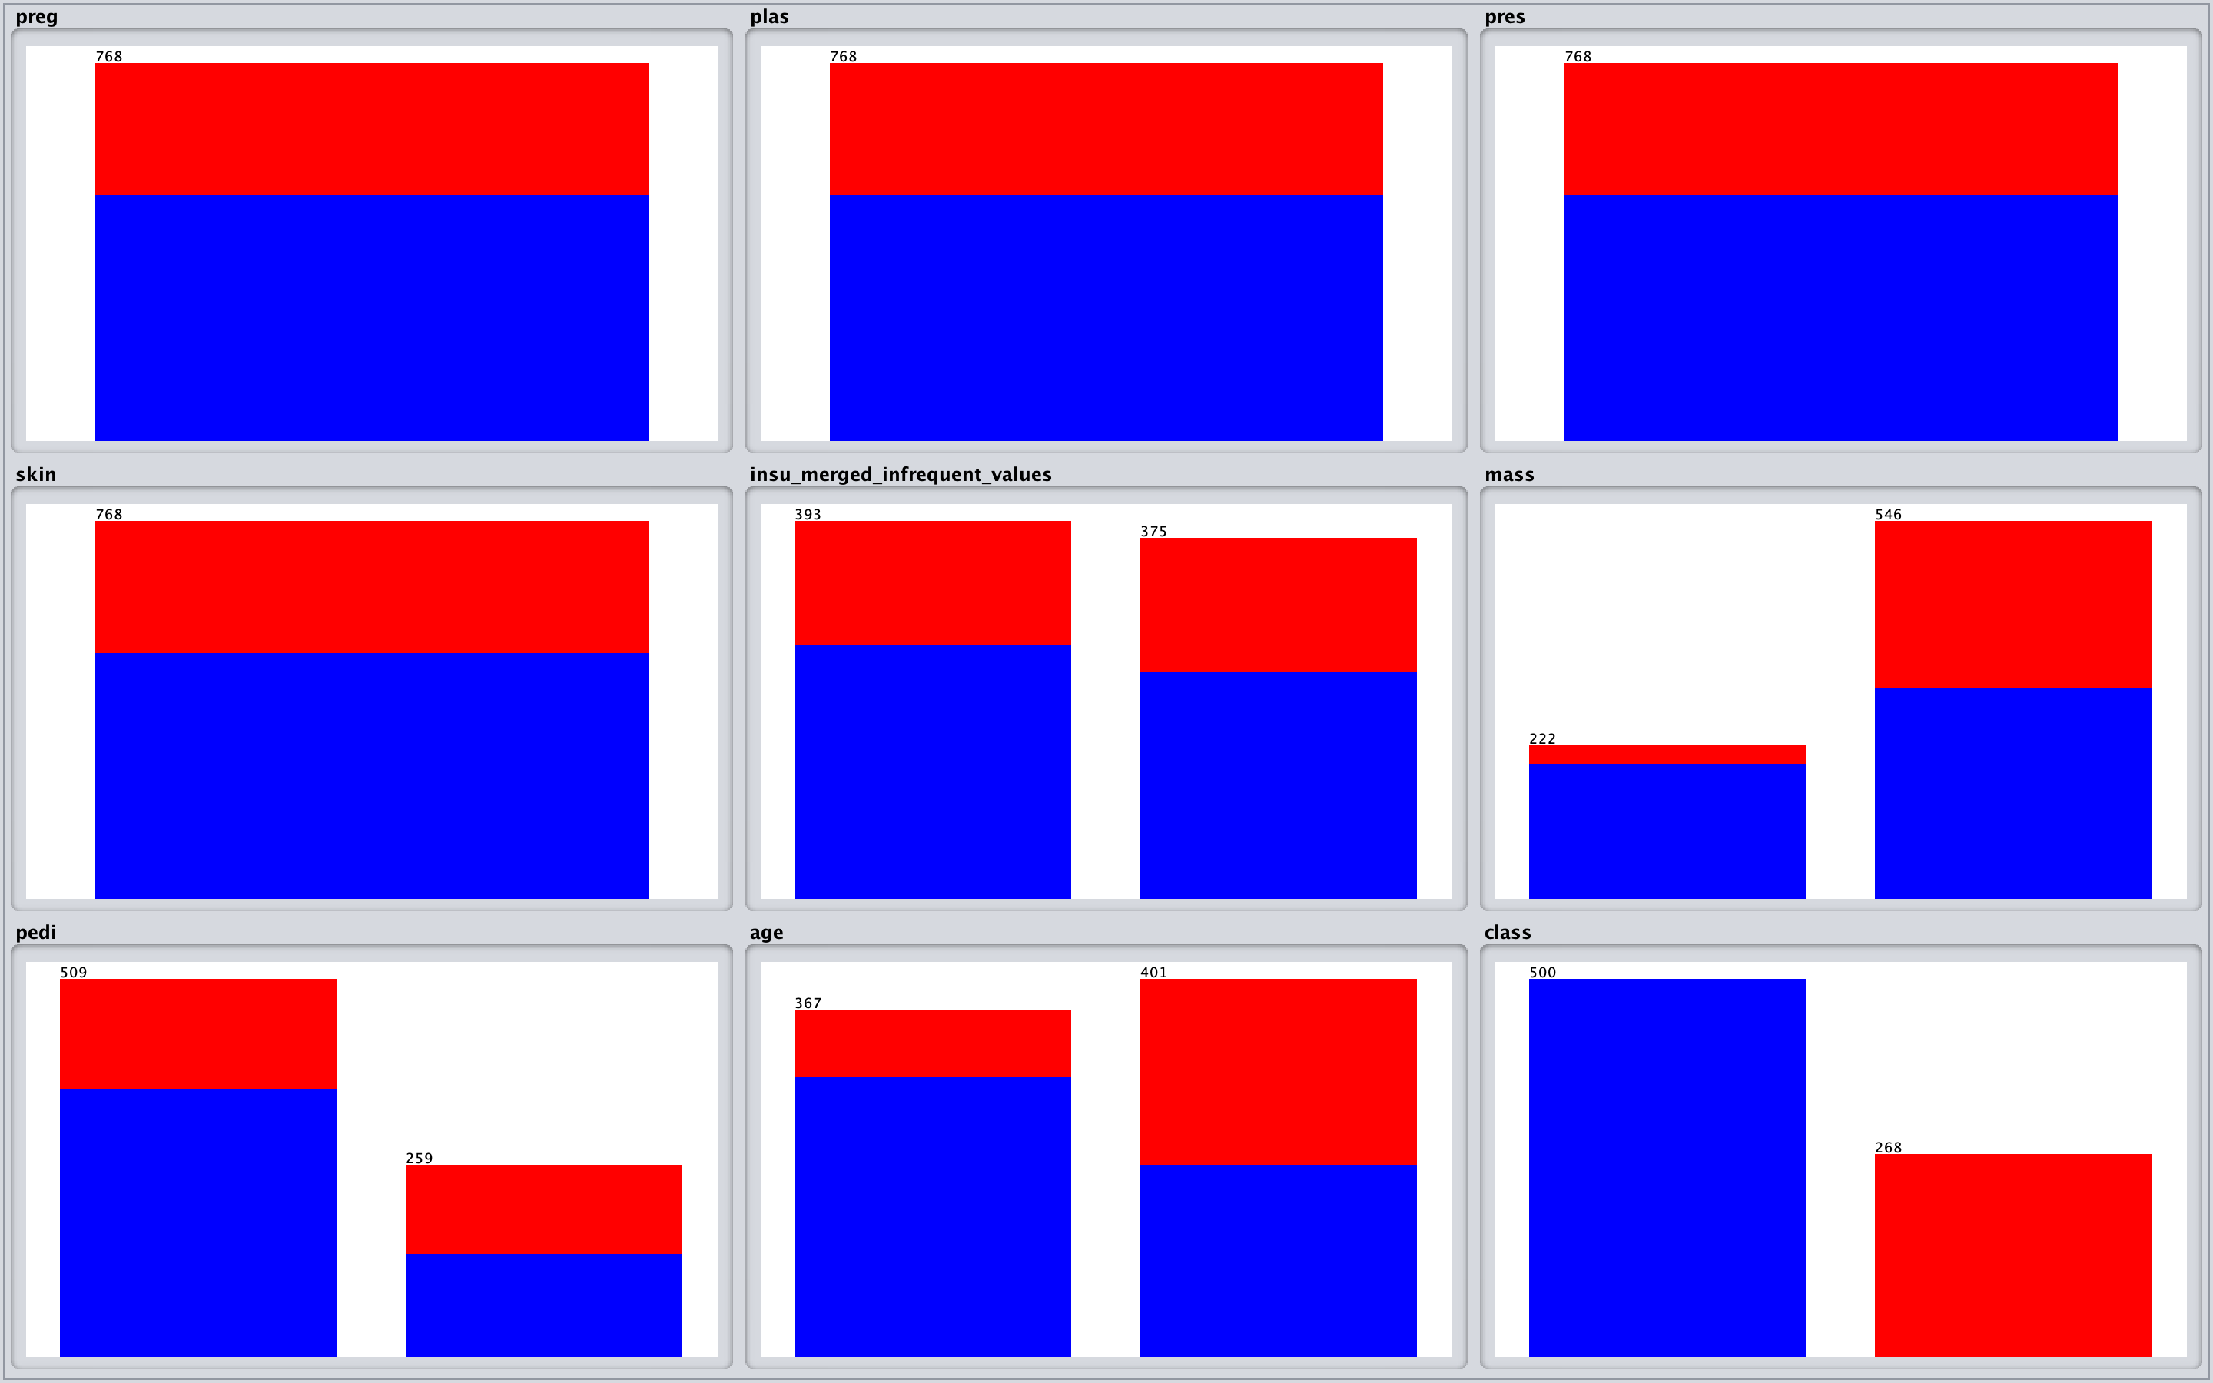
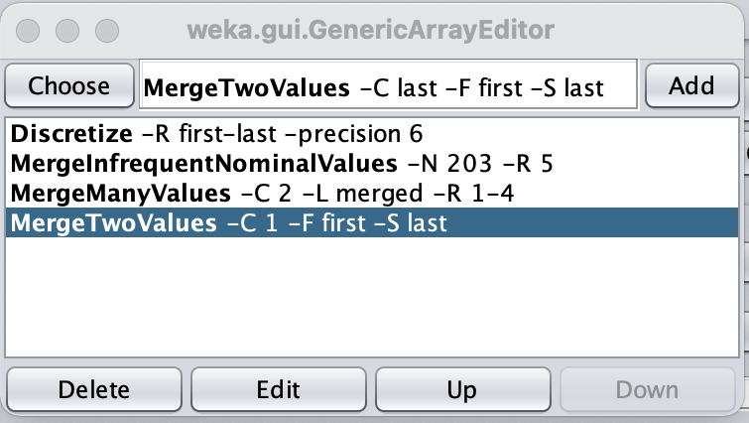
Diabetes.arff MergeFilter
MergeInfrequentNominalValues : Merge all bins that don’t contain at least 203 instances (in this case), the filter is applied to the 5th attribute
MergeManyValues : Merge the bins (1 to 4) of the attribute 2
MergeTwoValues : Merge two bins of the attribute 1

